Slide 1
D.C. Voluntary Sentencing Guidelines Advanced Training: How to calculate a defendant’s criminal history score
D.C. Sentencing and Criminal Code Revision Commission

Slide 2
Disclaimer
This PowerPoint presentation is designed to give individuals an understanding of how criminal history scored as calculated and used. The presentation is not intended to serve as legal advice or guidance. It does not cover every possible situation or occurrence. It is for educational purposes only.
This presentation should not be referenced, used, introduced, or quoted in any proceeding. It may not be reproduced without the expressed permission of the D.C. Sentencing and Criminal Code Revision Commission.

Slide 3
How to calculate a defendant’s criminal history score
This training will focus on calculating a defendant’s criminal history score.
Including:
How a defendant’s criminal history score effects the sentencing range.
How presentence report writers calculate a criminal history score.
How to challenge an initial criminal history score calculation.

Slide 4
How a defendant’s criminal history score effects his or her sentencing range
A Defendant’s Sentencing Guidelines Range is primarily based upon two factors:
The severity of the offense being sentenced; and
The defendant’s prior criminal history score.
Example:
Defendant is being sentenced for robbery
Defendant has a criminal history score of two

Slide 5
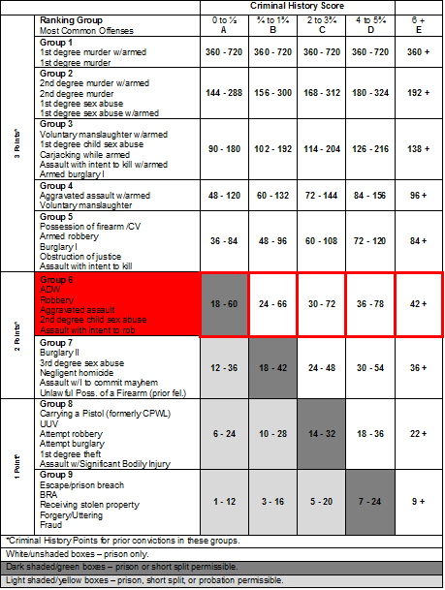

Slide 6
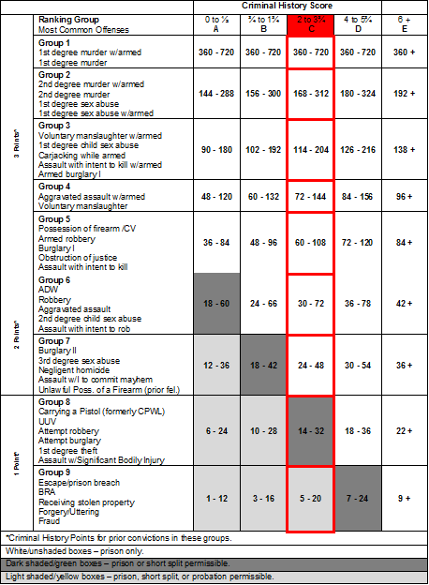

Slide 7
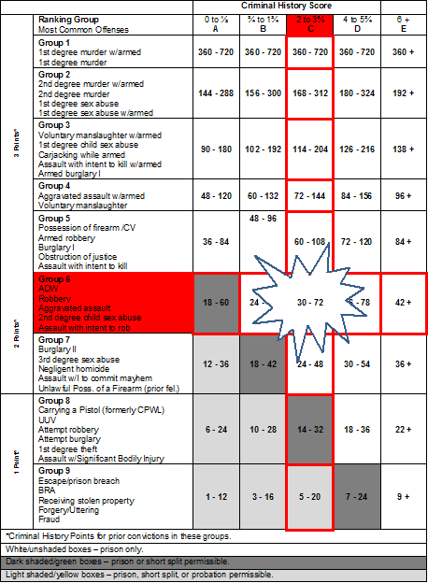

Slide 8
calculation of a defendant’s criminal history score
Criminal history score calculation is initially completed by the presentence report writer.
Score based on rules in Guidelines section 2.2.
Parties can challenge an initial criminal history score.
The court makes the final determination of a defendant’s criminal history score.

Slide 9
WHAT Prior conduct is scored?
Must be a prior conviction
Prior arrests, dismissals, acquittals, and diversion cases are not scored.
Pleas of nolo contendere, sentences under the Youth Rehabilitation Act, and Imposition of Sentence Suspended cases are scored.
Must have already been sentenced.
Cannot be part of the current event being sentenced.

Slide 10
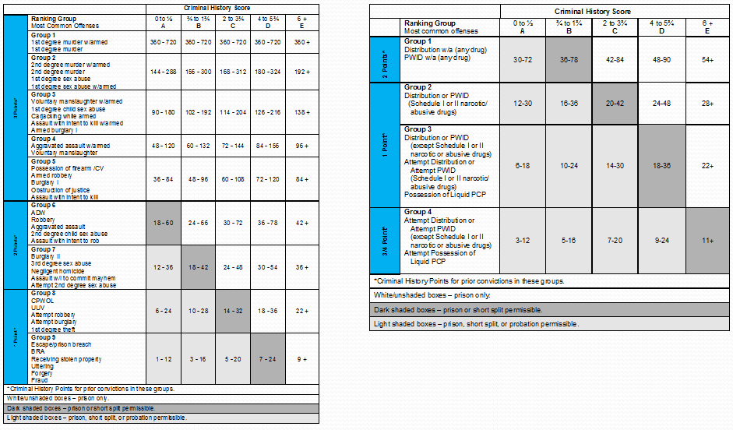
How are prior convictions scored?
Prior felony convictions are scored based on their Offense Severity Group.

Slide 11
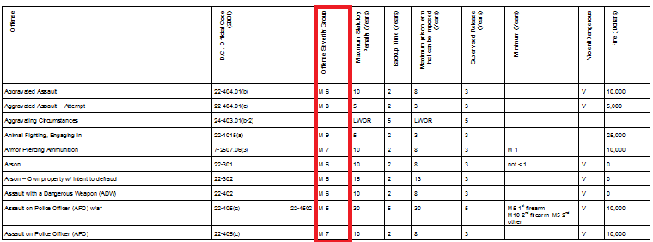
How are prior convictions scored?
Offense rankings not contained on the Master or Drug Grids are listed in Guidelines Appendix C (listed alphabetically) or C-I (listed by statute number)

Slide 12
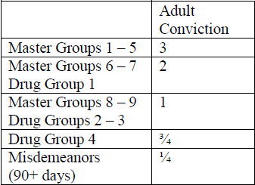
How are prior convictions scored?
Section 2.2.2 indicates how prior convictions are scored depending on the offense group.

Slide 13
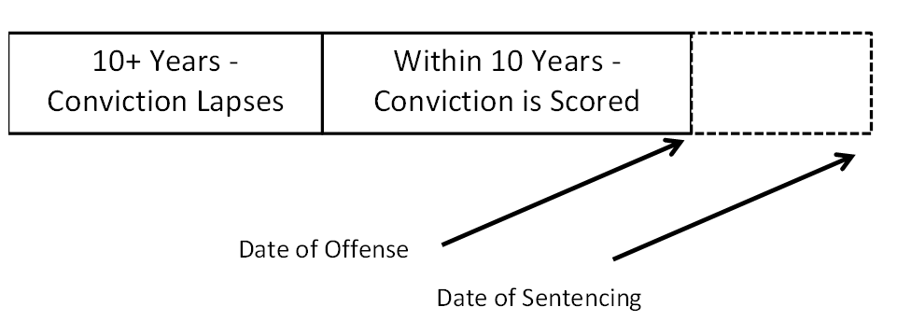
Lapsed Convictions
Only convictions within a ten-year window before the commission of the instant offense are scored.
Ten year window calculated from the end of the sentence in the prior case to the date of the commission of the case being sentenced.
Convictions outside of the ten year window lapse and are not scored.

Slide 14
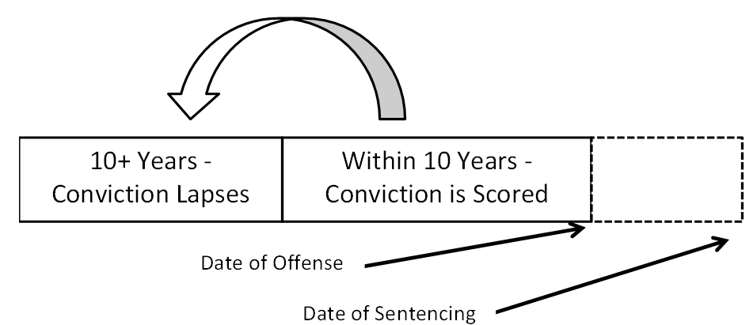
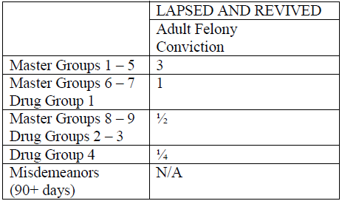
Revived Convictions
Lapsed convictions are revived if any prior felony sentenced occurs within the ten year window.
Revived convictions are scored as follows:

Slide 15
Scoring Prior misdemeanor Convictions
All misdemeanor convictions are scored as .25 points.
Total points from misdemeanors cannot exceed 1 point (4 misdemeanor).
Once lapsed, cannot be revived.
Cannot revive any prior offenses.
Misdemeanors with a statutory maximum sentence of less than 90 days are not scored.

Slide 16
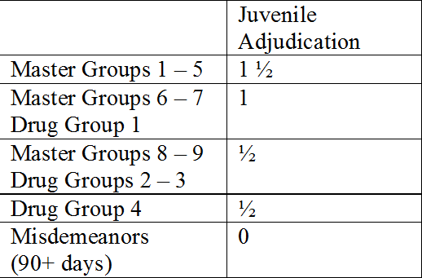
Scoring Prior Juvenile convictions/adjudications
Only felonies are scored (no misdemeanors).
Convictions lapse after five years .
Lapse time calculated from the day of sentencing unless the defendant is held in a secured (locked) facility.
Lapsed convictions cannot be revived.
Points from juvenile convictions cannot exceed 1.5 total points.
Unless there is more than one adjudication for an offense that counts as 1 ½ points. In that event, each such adjudication is counted and all other adjudications are not counted.
Juvenile convictions/adjudications are scored as follows:

Slide 17
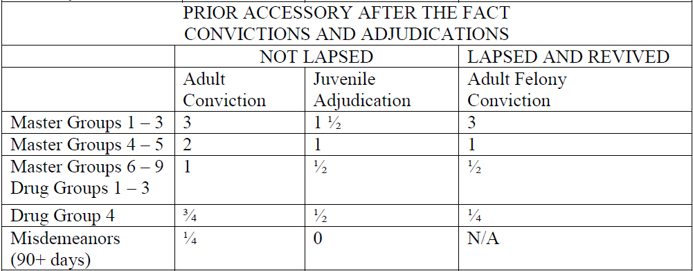
Prior accessory after the fact convictions
Prior accessory after the fact convictions are scored as follows (use the master group for the underling offense):

Slide 18
Scoring multiple offense from the same event
Only the most severe conviction from a single prior event is scored.
Offenses are part of a single event if they:
Were committed at the same time and place or
Have the same nucleus of facts.
Whether two or more offenses were part of the same event is often a factual question that must be resolved by the court.

Slide 19
Scoring out-of-District convictions - Initial Scoring
Rule 2.2.6(a) explains the procedure presentence report writers use to initially score an out-of-District offense.
Step 1 – Locate the Out-of-District statute.
Step 2 – Examine the name and elements of the Out-of-District offense.

Slide 20
Scoring out-of-District convictions - Initial Scoring (continued)
Step 3 – Based only on the name and elements of the offense, score the offense as the most closely matching D.C. offense.
Step 4 – If there is more than one closely matching D.C. offense, initially score the offense as the least severe offense. Make a note that the offense closely matched multiple D.C. offenses.
Note: CSOSA does NOT look at the underlying conduct.

Slide 21
Scoring out-of-district Convictions -Non-Comparable Offenses
An out-of-District offense that does not match a D.C. offense is scored as:
A one point felony if it is defined as a felony by the other jurisdiction.
A misdemeanor if it is defined as a misdemeanor by the other jurisdiction.
The PSI should indicate that the offense does not match.

Slide 22
Scoring out-of-district convictions - Contesting an initial scoring
The sentencing judge makes the final decision in how an out-of-District conviction is scored.
Parties may argue that CSOSA misapplied rule 2.2.6(a).
If a party contends that an initial scoring misrepresents the severity of the offense, they may seek a criminal history correction.
Procedure set forth under Rule 2.2.6(a)(6).
Can introduce the facts underlying the conviction.
If court finds by a preponderance of the evidence that the conduct underlying the conviction best matches a different District offense, it may change the scoring.

Slide 23
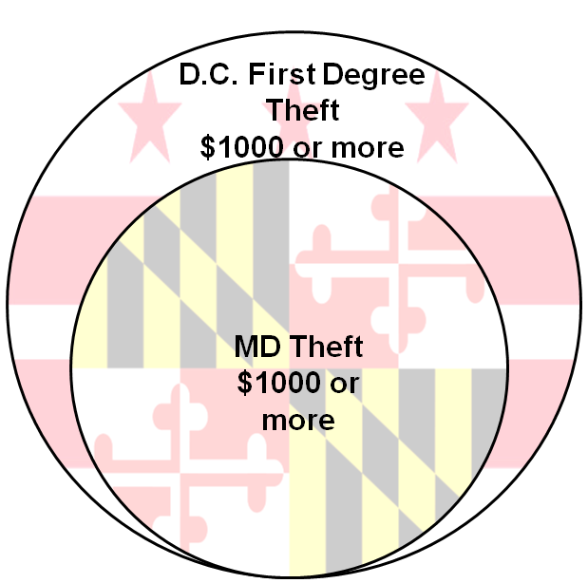
Scoring out-of-district convictions - Example 1
Maryland Felony Theft – After September 2009
Elements of Theft Closely Match.
$1000 Threshold.
Result:
Matches Theft 1 in D.C.
($1000+).

Slide 24
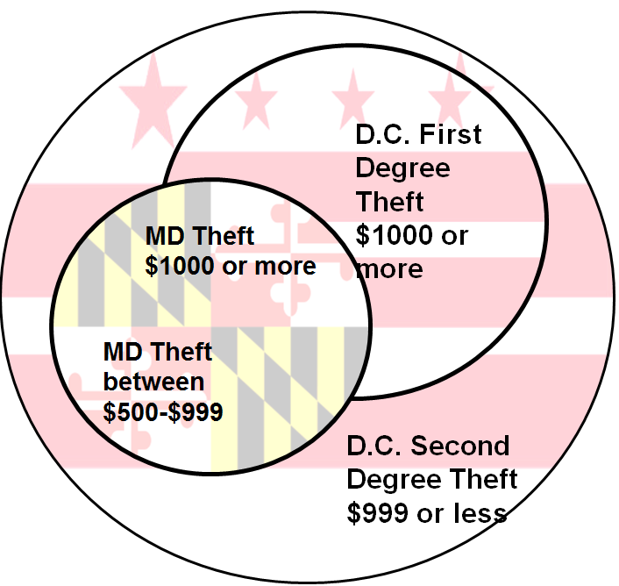
Scoring out-of-district convictions - Example 2
Maryland Felony Theft – Before October 2009
MD has a $500 Threshold.
Result: Could closely match either Theft 1 or Theft II in D.C.
Initially scored as Theft II with a note.
Government could try to prove facts of conviction were $1000 or more.

Slide 25
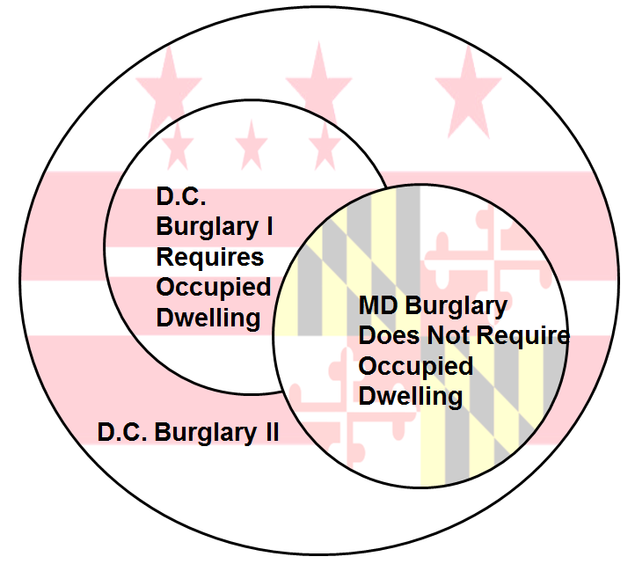
Scoring out-of-district convictions - Example 3
Maryland Burglary
Elements of Burglary Similar to D.C., but does not require an occupied dwelling.
D.C. Burglary
Burglary I requires an occupied dwelling.
Burglary II does not require an occupied dwelling.
Result: Could match either Burglary I or II.
Initially scored as Burglary II with a note.
Government could introduce evidence to prove dwelling was occupied at time of burglary.

Slide 26
How to challenge a defendant’s Criminal History score calculation
Party should immediately notify the opposing party, the court, and CSOSA.
Provide information on why the challenging party believes a particular conviction or date is incorrect.
If a party intends to submit evidence or information that another party might want to contest, the moving party should notify all parties as soon as possible.

Slide 27
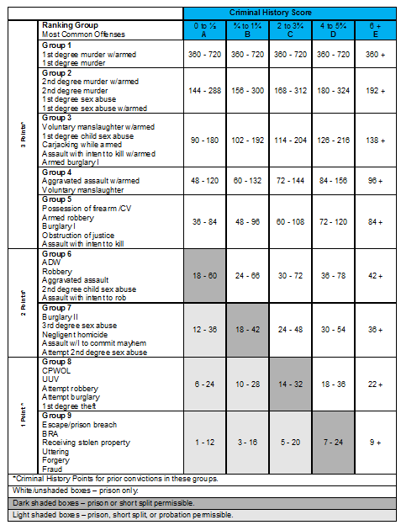
Calculating the Final Score
Add up all of the scored juvenile, adult, and lapsed offenses.
Determine the defendant's criminal history score column based upon his or her total score.

Slide 28
Calculating the Final Score - Example
A defendant has the following scored convictions:
Robbery (as a juvenile)
Robbery
Armed Robbery
Misdemeanor Assault
Convictions are scored as follows:
Robbery (as a juvenile) – 1 point (slide 15)
Robbery – 2 points (slide 10 & 11)
Armed Robbery Accessory After the Fact– 2 points (slide 16)
Misdemeanor Assault .25 points (slide 14)

Slide 29
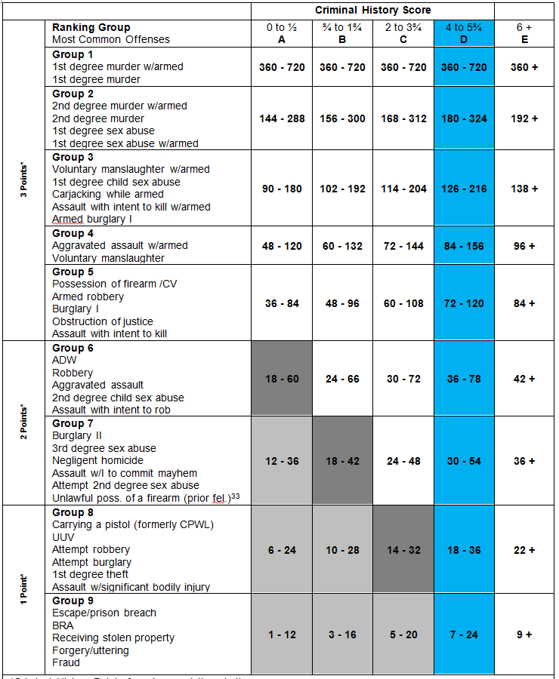
Calculating the Final Score - Example
Total Score 5.25.
5.25 falls in Criminal History Column D.

Slide 30
Additional Questions
The D.C. Sentencing and Criminal Code Revision Commission is available to answer general questions about the Voluntary Sentencing Guidelines.
The Commission can be reached at:
www.sentencing.dc.gov
202-727-8822
sentencing@dc.gov

