Slide 1
D.C. Voluntary sentencing guidelines training
Scoring Juvenile Adjudications and Misdemeanors
April 10, 2019

Slide 2
Outline of Session
Juvenile Adjudications – What “Counts”?
Juvenile Adjudications – Basic Scoring Rules
Juvenile Adjudications – Lapsing and Reviving
Juvenile Adjudications – The 1 ½ Point Cap
Juvenile Adjudications from Outside of D.C.
Misdemeanors – Basic Scoring Rules
Misdemeanors – How This Works in Practice

Slide 3
Juvenile Adjudications – What “Counts”?
The basic rules for determining what “counts” as a juvenile adjudication for scoring purposes:
Juvenile adjudications for offenses in Master Groups 6-9 and all Drug Groups “count” for scoring purposes if the amount of time between the date of initial disposition or the date of release from New Beginnings on the prior case (which is later) and the commission of the instant offense is five years or less.
Juvenile adjudications for offenses in Master Groups 1-5 “count” for scoring purposes if the amount of time between the date of initial disposition, the date of release from New Beginnings, or the date of release from a locked facility on the prior case (whichever is later) and the commission of the instant offense is five years or less.
Juvenile misdemeanors do not count.

Slide 4
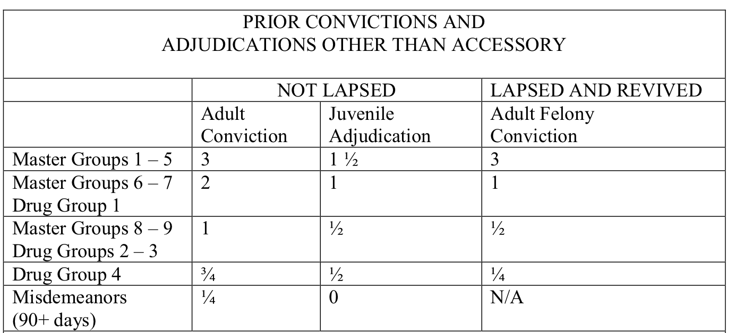
Juvenile Adjudications – Basic Scoring Rules
Use the table in Section 2.2.2 of the VSGM:

Slide 5
Juvenile Adjudications – Lapsing and Reviving
Juvenile adjudications lapse, and are not scored, if they are beyond the five-year window. A juvenile conviction that has lapsed can never be revived.

Slide 6
Juvenile Adjudications – Lapsing and Reviving
Example 1: A juvenile is initially placed on probation; probation is later revoked and the juvenile is committed to DYRS and sent to a group home; he is later released to aftercare. The date of probation controls the calculation of the 5-year window.
Example 2: A juvenile is initially committed to DYRS and sent to New Beginnings; he is eventually transferred to a group home and later released to aftercare. The date of his release from New Beginnings controls calculation of the 5-year window.

Slide 7
Juvenile Adjudications – The 1 ½ Point Cap
Juvenile Adjudications are capped at 1 ½ points.
But, if there is more than one prior adjudication for an offense that itself counts as 1 ½ points, each such adjudication is counted and all others are not.
Example 1:
Defendant has one prior adjudication for Burglary II (1 point) and two prior adjudications for receiving stolen property (½ points each). Total criminal history score = 1 ½ (even though the actual total is 2).
Example 2:
Defendant has two prior adjudications for Armed Robbery (1 ½ points each) and one prior adjudication for drug distribution (½ points). Total criminal history score = 3 (both Armed Robberies count and the drug distribution does not).

Slide 8
Juvenile Adjudications from Outside of D.C.
Follow the general rules for scoring out-of-District offenses.
If no comparable D.C. statute that closely matches the out-of-District adjudication, apply these rules:
Apply ½ point for all juvenile adjudications for offenses the other jurisdiction classifies as felonies if committed by an adult.
Do not score juvenile adjudications for offenses the other jurisdiction classifies as misdemeanors if committed by an adult.

Slide 9
Misdemeanors – Basic Scoring Rules
Adult misdemeanors generally count, with some exceptions:
Adult misdemeanors do not count if they have lapsed (misdemeanors cannot be revived).
Adult misdemeanors do not count if they exceed the 1 point cap (only 4 can count).
For adults, a prior misdemeanor conviction is scored according to the maximum penalty: ¼ point if 90 days or more; offenses with a maximum penalty of less than 90 days are not scored.
Juvenile misdemeanors are never scored.
Misdemeanors are never revived.

Slide 10
Misdemeanors – How this Works in Practice
Example 1:
A defendant has one misdemeanor conviction from 2006 and one felony from 2016. Assuming he is being sentenced today for an offense committed earlier this year, would the misdemeanor count towards his criminal history score?
Example 2:
A defendant has one misdemeanor conviction for each of the following years: 2012, 2013, 2014, 2015, and 2016. Assuming he is being sentenced today for an offense committed earlier this year, how many of these count toward his criminal history score?
Example 3:
A defendant has one juvenile adjudication for Theft II. What is his criminal history score?

Slide 11
Additional Resources and Commission Staff
Please feel free to contact the Commission with additional questions or for assistance with specific cases.
Contacting the Commission with general questions:
scdc@dc.gov
(202) 727-8822
For specific questions about the Guidelines:
General Counsel Kara Dansky
Kara.dansky@dc.gov
(202) 727-7934
Additional resources, including the Voluntary Sentencing Guidelines Manual: http://scdc.dc.gov

